Slide 1
Software Engineering and Architecture
Pattern Catalog: Command

Slide 2
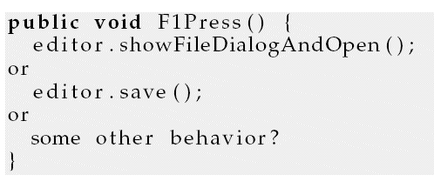
Command
A parametric solution?
No. Can only handle those case I have imagined in advance ☹
In my word processor system I would like the user to configure what the F1 button does freely
  Like ‘save’ or ‘open new file’ or ?
  Or perhaps record a macro of key strokes in F1
    F1 => insert text ‘iskagefabrik’ at the cursor position
But how to code this?

Slide 3
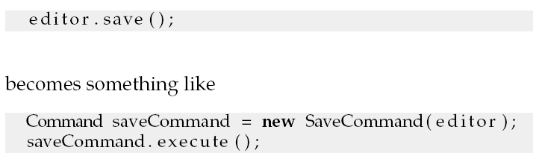
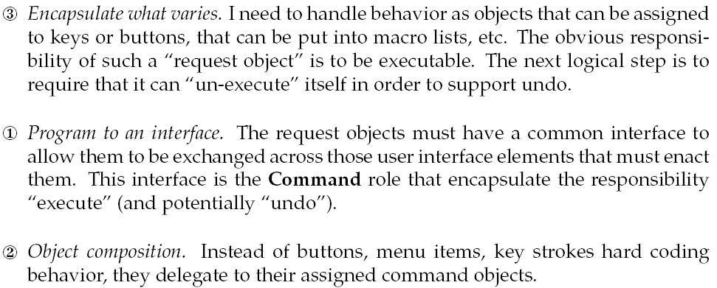
3-1-2

Slide 4
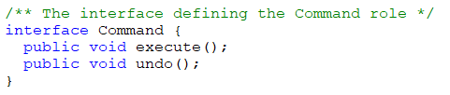
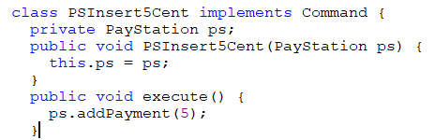
Our Command Interface
Pretty simple!
Any instance of this represents one method invocation to be made to one object
  Example:
ps.addPayment(5)

Slide 5
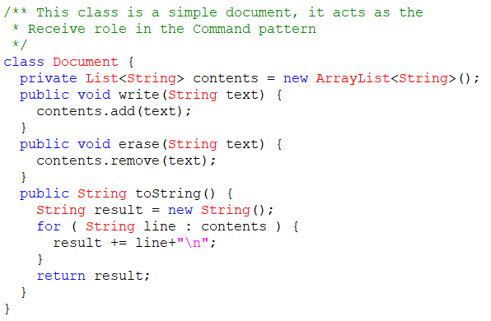
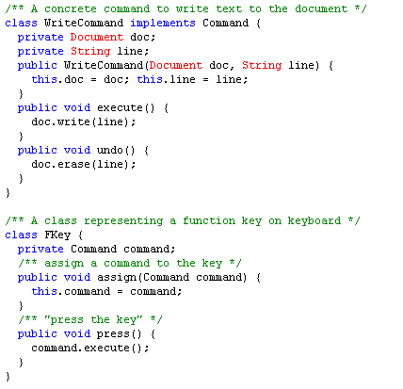
Demo

Slide 6
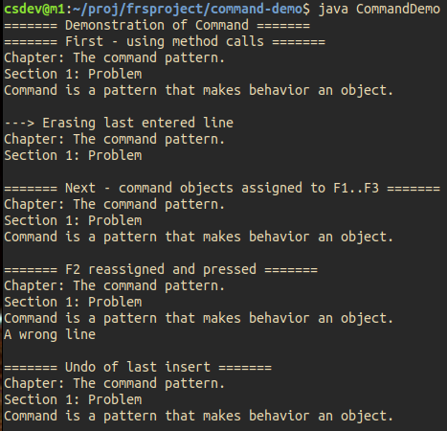
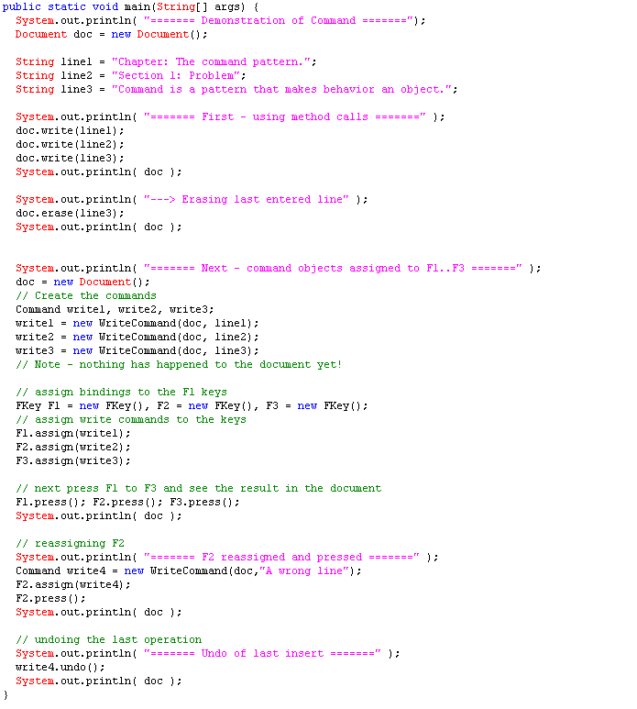
Demo

Slide 7
Demo

Slide 8
Demo

Slide 9
Demo

Slide 10
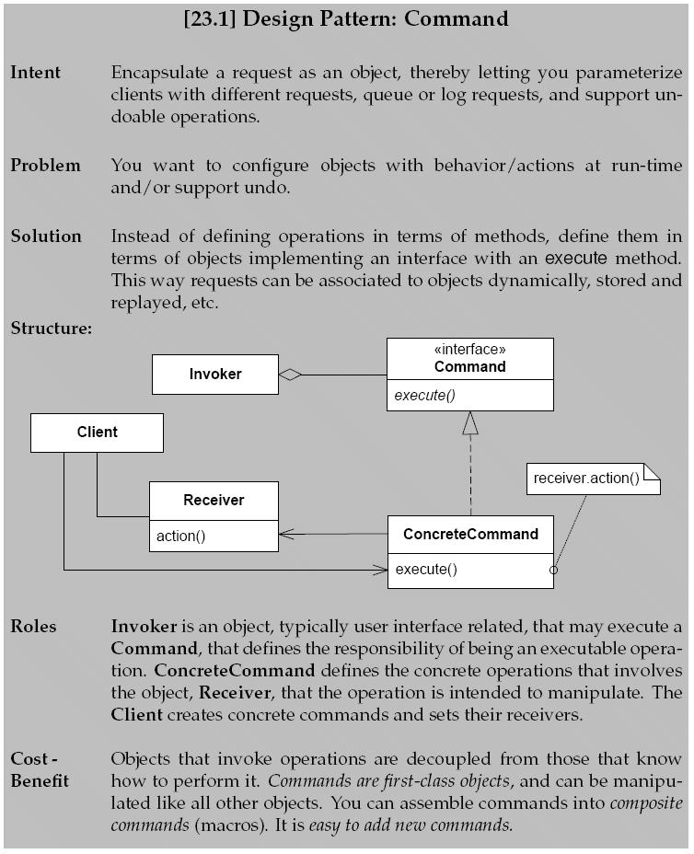
Command

Slide 11
Consequences
Benefits
  Decouples clients from set of commands
  Command set can be extended at run-time
  Easy to support multiple ways to execute command (menu, pop up, shortcut key, tool bar, …)
  Commands are first-class objects
    Log them, store them
  Assembling macros is easy (composite of commands)
  Undo can be supported
    Add an ‘unexecute()’ method, and stack the set of executed commands.
Liability: Cumbersome code for calling a method

